Slide 1

Mental Health Illness - Statistics among Youths (2009 vs. 2019)
Manisha Singh

Slide 2
Table of Content
Introduction
Methodology
Youth Mental Health Statistics - 2009 vs 2019
Data Source Strengths
Data Source Weaknesses
Reflection
Conclusion

Slide 3
Introduction
Mental Health includes emotional, psychological, and social well-being¹.
Factors that contribute to mental health include-
Gene or brain chemistry
Life experiences such as (abuse and traumatic injury)
A family history of mental problems

Slide 4
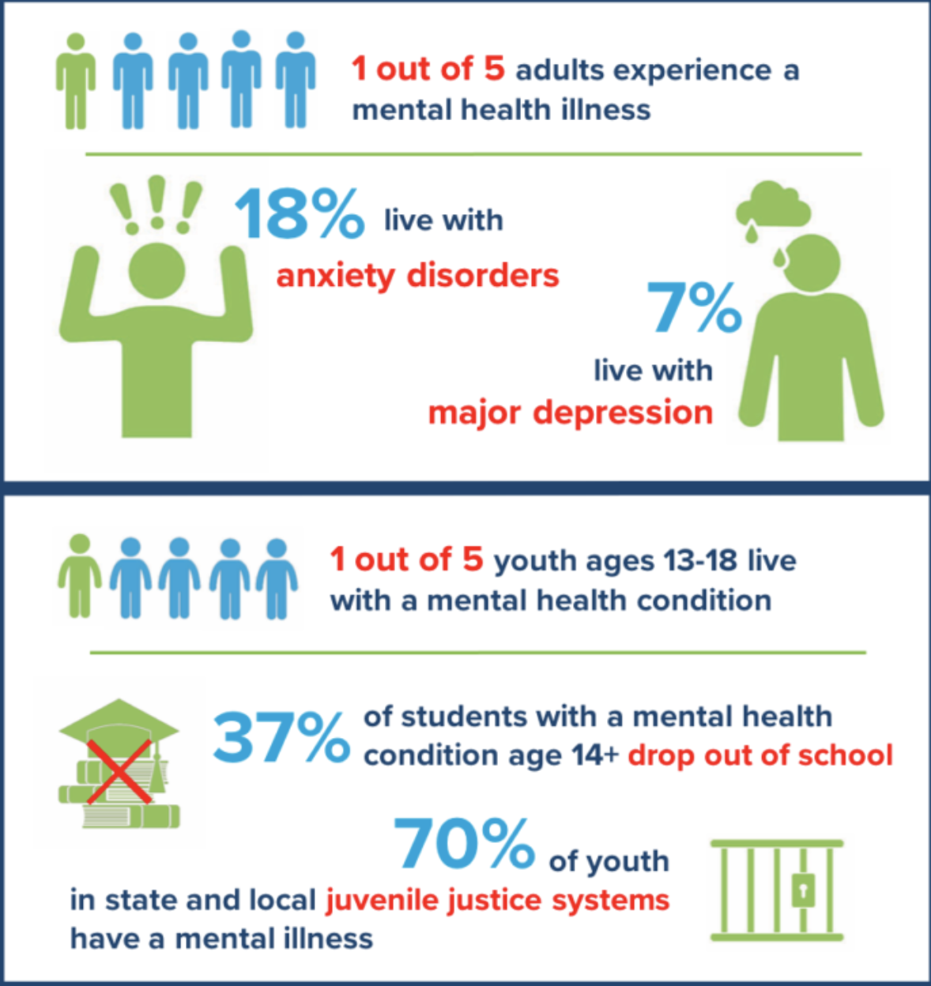
Introduction
*NIHCM

Slide 5
Methodology
Youth Risk Behavioral Surveillance System (YRBSS) Data obtained from CDC website https://www.cdc.gov/healthyyouth/data/yrbs/data.htm.
Raw Files, Data Documentations and SAS Input Programs obtained for Survey years 2009 and 2019.

Slide 6
Methodology
Created Separate permanent SAS Datasets for 2009 and 2019 survey results keeping only variables required to support analysis.
Vertically combined both datasets to create a permanent master dataset with an identifier specifying record year.
Used SAS procedures Transpose, Means and Sgplot to generate tables and visuals depicting the mental health statistics in 2009 vs 2019.

Slide 7
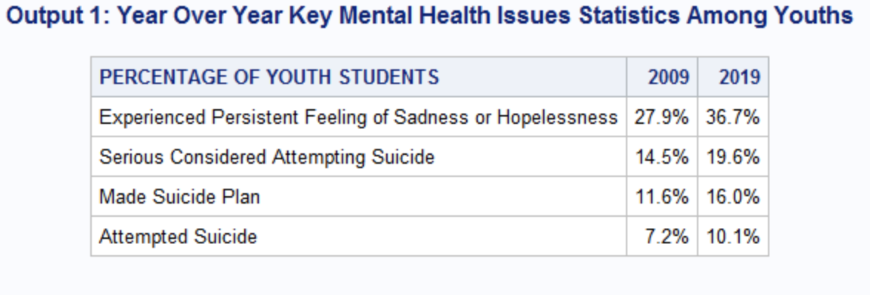
Youth Mental Health Statistics – 2009 vs 2019
*Number of Respondents in 2009 -16,410 and in 2019 - 13,677.

Slide 8
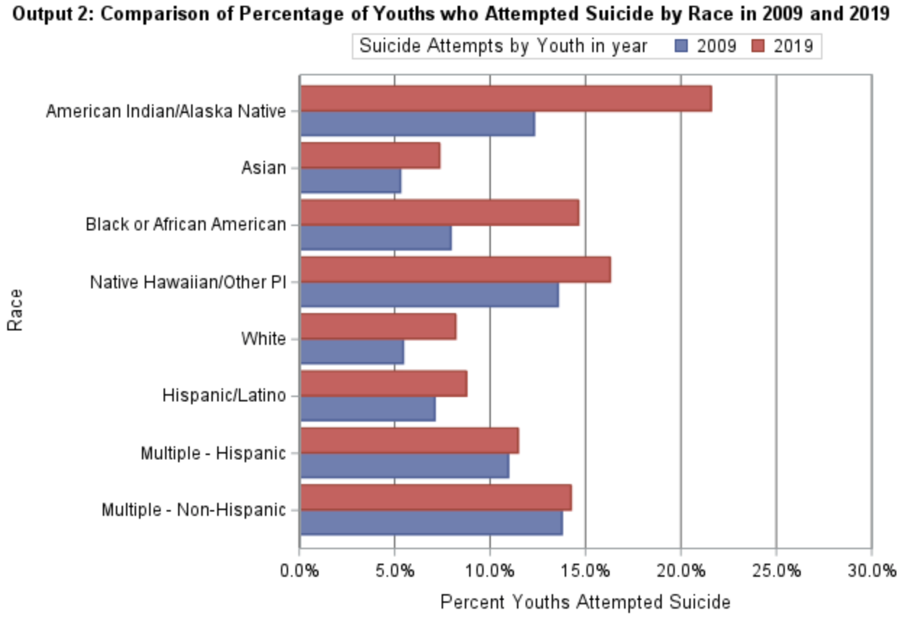
Youth Mental Health Statistics – 2009 vs 2019

Slide 9
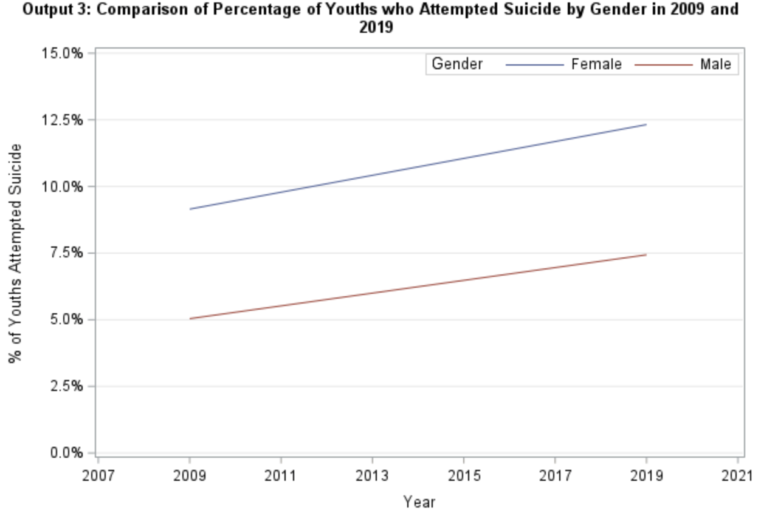
Youth Mental Health Statistics – 2009 vs 2019

Slide 10
Data Source Strengths
Easy Access – It is very easy to download the project files through simple steps.
10,000 Feet View – It provides a high-level view of the health issues which can be used to track prevalence.
Cross-sectional Study – Core questions remain same across years enabling cross sectional study to compare trends.

Slide 11
Data Source Weaknesses
Missing Data – Youths may not answer few questions as it is a self-reported survey. It may require Imputation methodologies to fill missing data.
Lack of Detail – The survey does not provide detailed level analysis to do root cause analysis.
Not Generalizable – It is based on high school students, can’t generalize for drop-out students². No classification provided for transgenders.

Slide 12
Reflections
Higher Prevalence – Overall Higher Prevalence of Mental health issues in 2019 as compared to 2009.
Racial Disparity – Youths belonging to racial minority groups face increased Mental Health issues as compared to Whites.
Gender Disparity – Higher Prevalence of Mental Health issues in females in comparison to males. Results consistent across years.

Slide 13
Conclusion
Basic Knowledge – The analysis provides basic rudimentary information regarding prevalence of mental health issues which are increasingly becoming common among Youths.
Further Research – Deep Dive Analysis is required to further analysis reasons for the increased prevalence.

Slide 14
?
Questions

Slide 15
References
CDC. (2021). About Mental Health. Retrieved on November 20, 2022, from https://www.cdc.gov/mentalhealth/learn/index.htm
Institute of Medicine (US). (2021). Existing Surveillance Data Sources and Systems. Retrieved on November 20, 2022, from https://www.ncbi.nlm.nih.gov/books/NBK83157/

